Slide 1
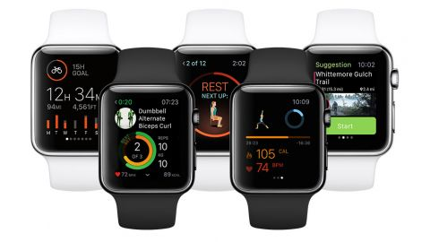

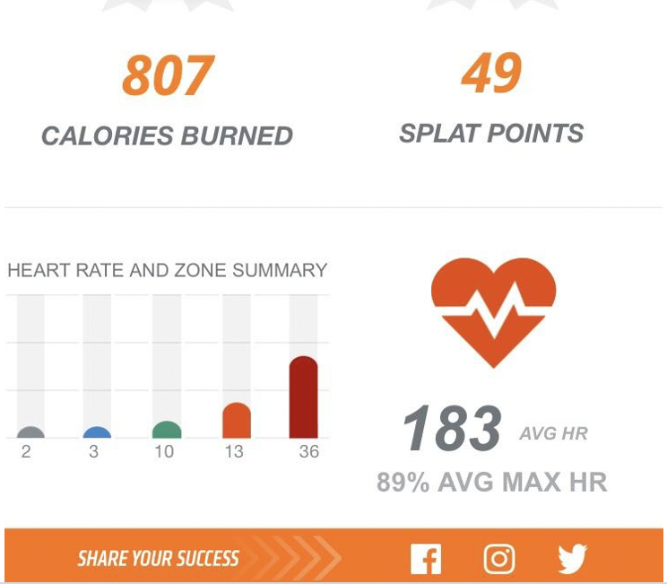
FITNESS BIT

Slide 2
Problem
User data stored in smart devices are subject to hack/breach and hence the data must be kept private and secure , this is where the blockchain comes into picture
Trainers in the gym are subject to have their income deducted for the use of the gym facility as Studios take a percentage of Trainers revenue in exchange to the user of their studio
Not everyone is familiar with blockchain platform and therefore the predicted spike in demand at the moment is relatively low
Working out in gym packed with the crowd waiting for machines can be sometimes intimidating and most importantly can turn out expensive, besides your timetable may not fit the needs
If user is self-motivated and doesn’t like exercising at home and prefers to have a workout environment
Most of the online programs doesn’t provide you with an opportunity to see your instructor , in which case the user can inadvertently perform exercises unsafely or incorrectly
Is the Fitness Instructor licensed or have the right knowledge to conduct fitness training
Majority of the people are unsure about what type of programs they want to join

Slide 3
Solution
As per Forbes, pandemic has struck in the form of Covid19 bringing the global economy to a halt, there has been a huge decline in the gym memberships and an outstanding boom in the online subscriptions, the requirement for on demand fitness classes is opening the doors for an Amazon/Netflix like services to gain propulsion with consumers
With Blockchain Technology, fitness trainers and AI driven apps can let go brick-and-mortor studios that sell their services face to face to a consumer
The consumers are demanding content when they need it wherever they are located
Fitness bit will offer the instructor and the user to interact with each other online , this way the trainer can instruct or correct the user in real time if they were to perform any exercises incorrectly or unsafely
Fitnessbit ensures to only enroll licensed & certified Fitness Instructor who has a proper knowledge on conducting fitness training, this provides assurance to the user that they are in safe hands
Fitness bit gives you an opportunity to test out different programs from the comfort of your home with a certified and licensed fitness trainer

Slide 4
Customers
Individuals who are looking for Health & Training Remotely without stepping out of their home
Gym Members
Exercise Motivation/health Conscious
Data and Security Privacy
Sports Enthusiasts
Sponsors- personal trainers , sports clubs, Gym owners
Members who owns wearables
Service providers – Digital Products,, National Brands

Slide 5
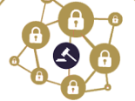
Products & Service
Gamification
Tier Status level
Immediate purchases
No intermediate approver
Gym Rewards Mining app
Decentralized data repository
Blockchain controlled by members to ensure security
Payment
Market place
Digital video , supplements, nutrition plans
Gym Studio Partnership
Mining
Data
Rewards Exchange
Earn Fitnessbit coins
Gym Equipments Manufacturer or
Supplement provider
GYM
Trading
Blockchain
Offers
Manufacturer
Workout
Trainers
Workout Plan
Powered by Artifcal Intelligence
Digital Health and Fitness Record
Trainers
Certified and licensed Trainers

Slide 6
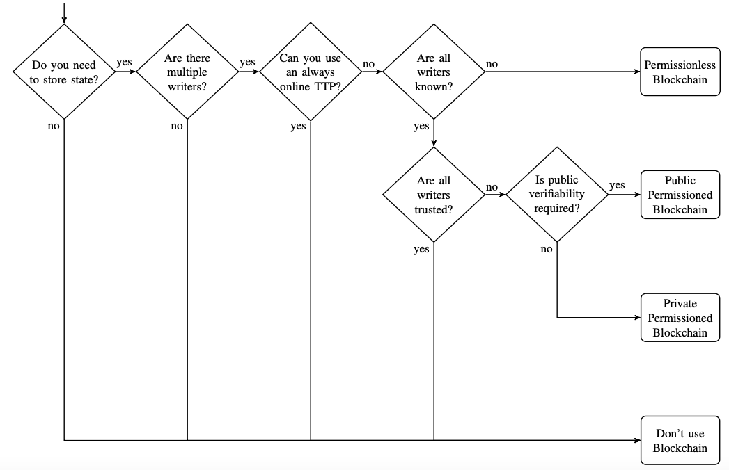
Do You Need A Blockchain

Slide 7
BlockData
Customers:
Basic data ( Age, Sex, Height and Weight)
Exercise data (Time, Sets, Actions)
Heart Rate
Oxygen saturation
Training Program
Trainers/Coaches:
Professional major
Training program
Manufacturer/Supplement
Training equipment
Protein Powder
Diet meals

Slide 8
BlockData
Training program
Title
Trainer
Trainee
Time
Tokens
Contract
Items
Customer / Trainer
Manufacturer / Supplement
Shipment info

Slide 9
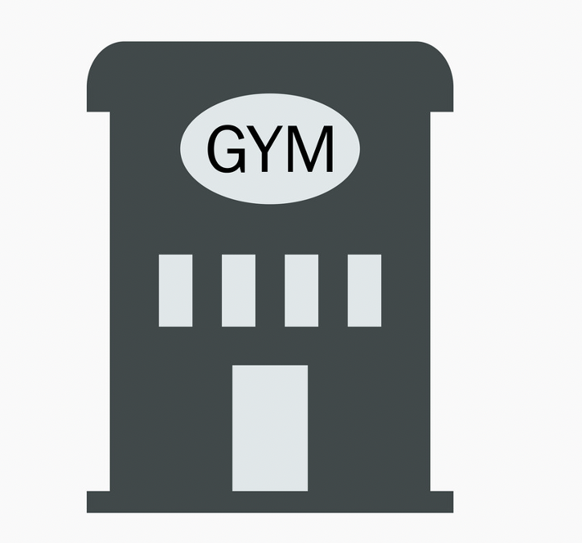


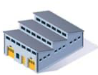
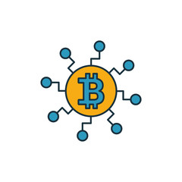

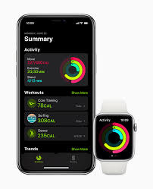
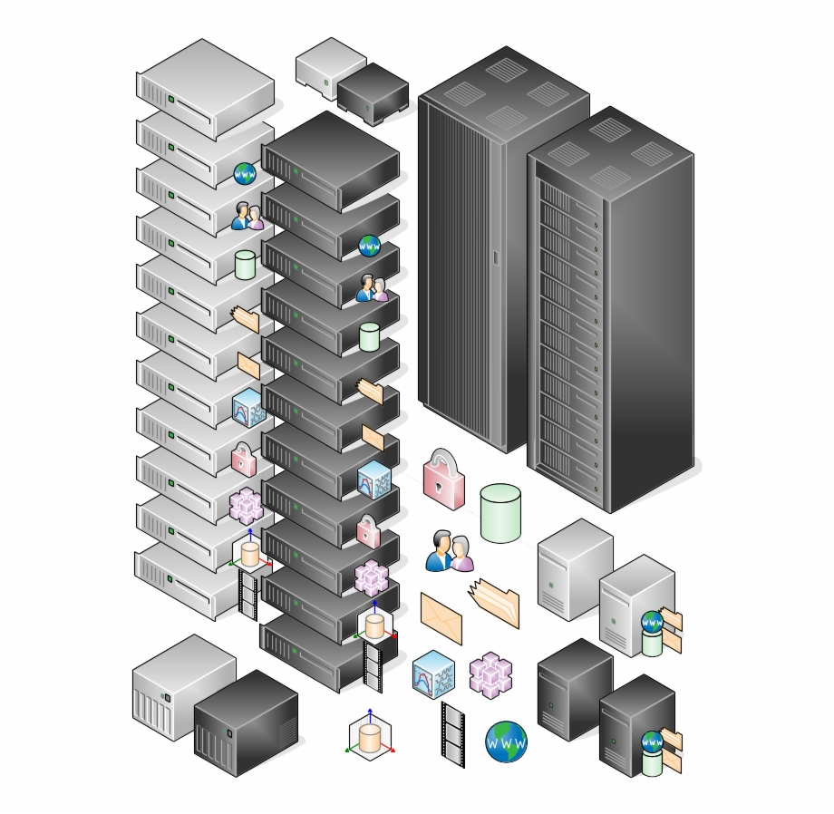

Technical Solution
Third Parties
Fitness machines manufacturers and Supplements
data
AI
Fitness bit Studios
Statistics
data
Statistics
Block Chain Node
User with Fitnessbit App
User private key
Fitness bit Core
Private key Storage

Slide 10
Data Privacy and Security
In contrast to extensive use of smartphones , fitness and health applications, it has become most eminent to track daily workouts, calories burnt, keeping a track of workout routines etc
Fitnessbit is built on an encrypted blockchain network that activates privacy and security with each and every transaction
We offer a strong privacy policy i.e, 100% GDPR complaint
As all the data is stored on Blockchain Network, Fitnessbit will not store any user data and hence users will have full priv/control over their health information
Fitnessbit also prohibits the sale of User data to any third party

Slide 11
Coin Budget
Soft Cap : 1 mil. $
Hard Cap : 10 mil. $
Token in presale : 15%
Private sell 1 mil. $ - 20 mil. Coins
Total Supply : 1 534.555.445 coins

Slide 12
Issues
How can we make a profit?
How to persuade supplements and trainers to make deals with us?

